Slide 1
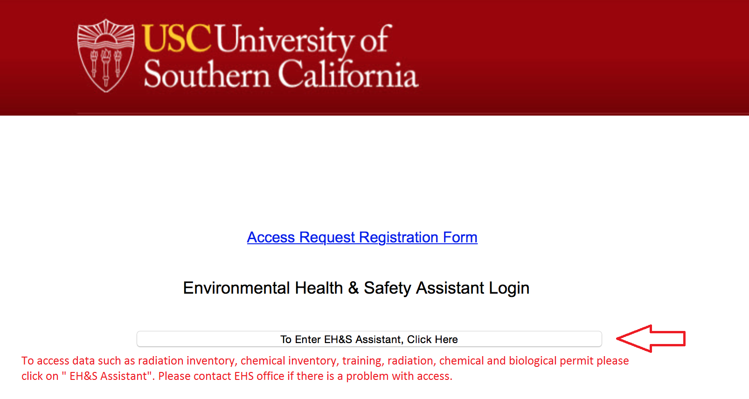
Click on PI Name

Slide 2
EHSA dashboard

Slide 3
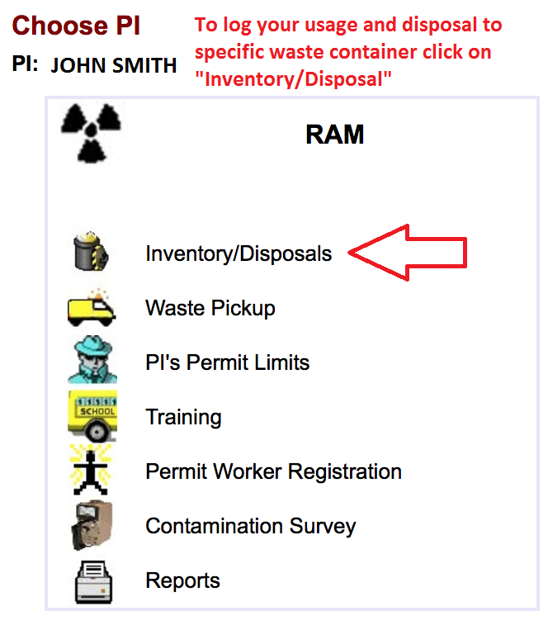
Radiation Module
Please follow the instructions to log your isotope usage and record disposals

Slide 4
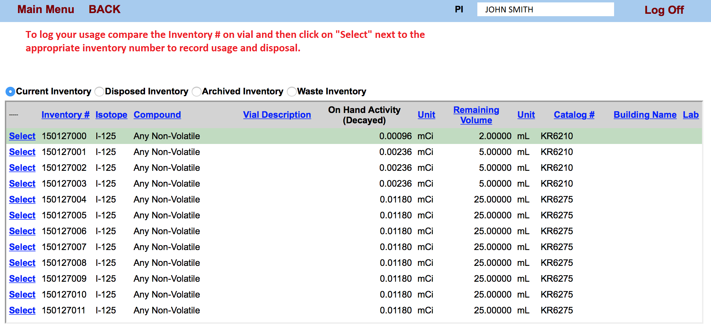
Inventory management

Slide 5
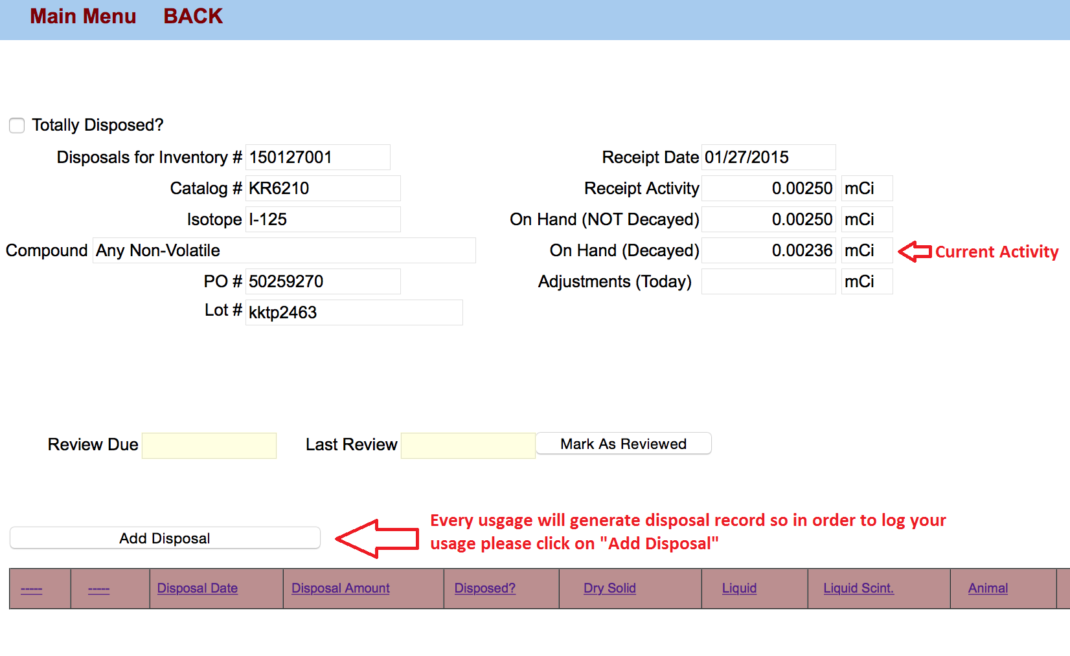
Inventory Usage and Disposal Log

Slide 6
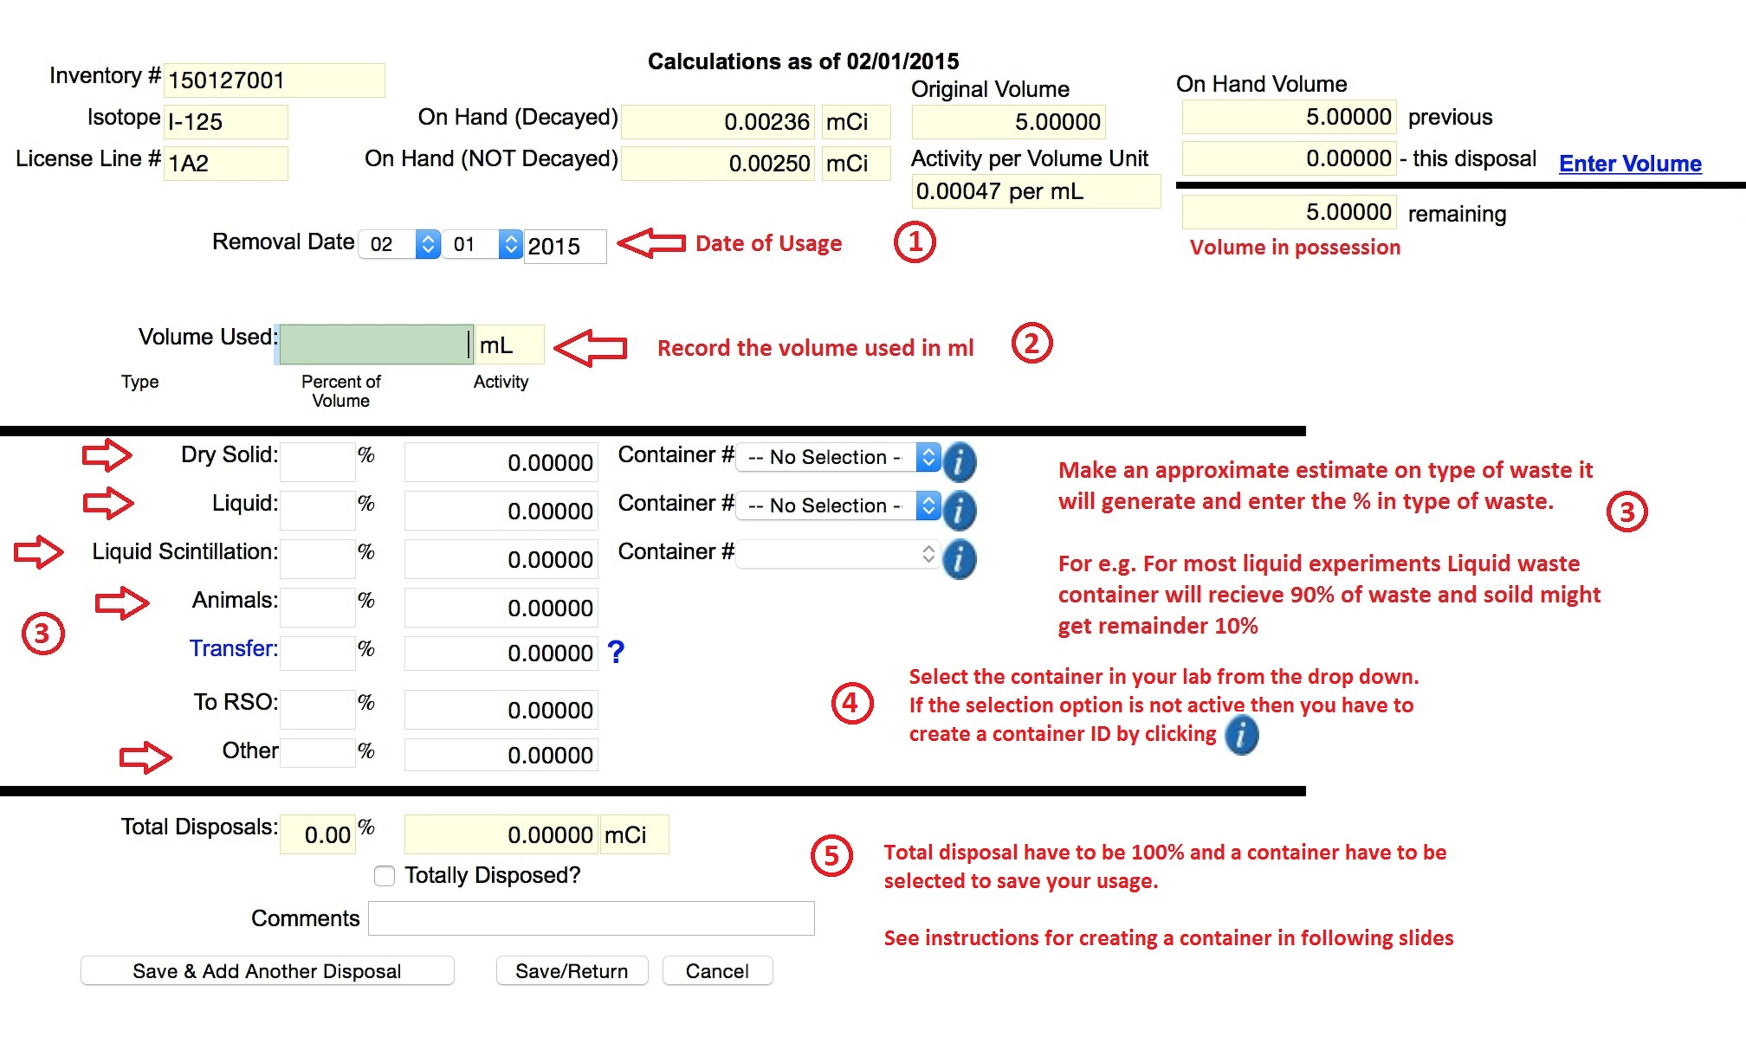
Recording Usage and disposal

Slide 7
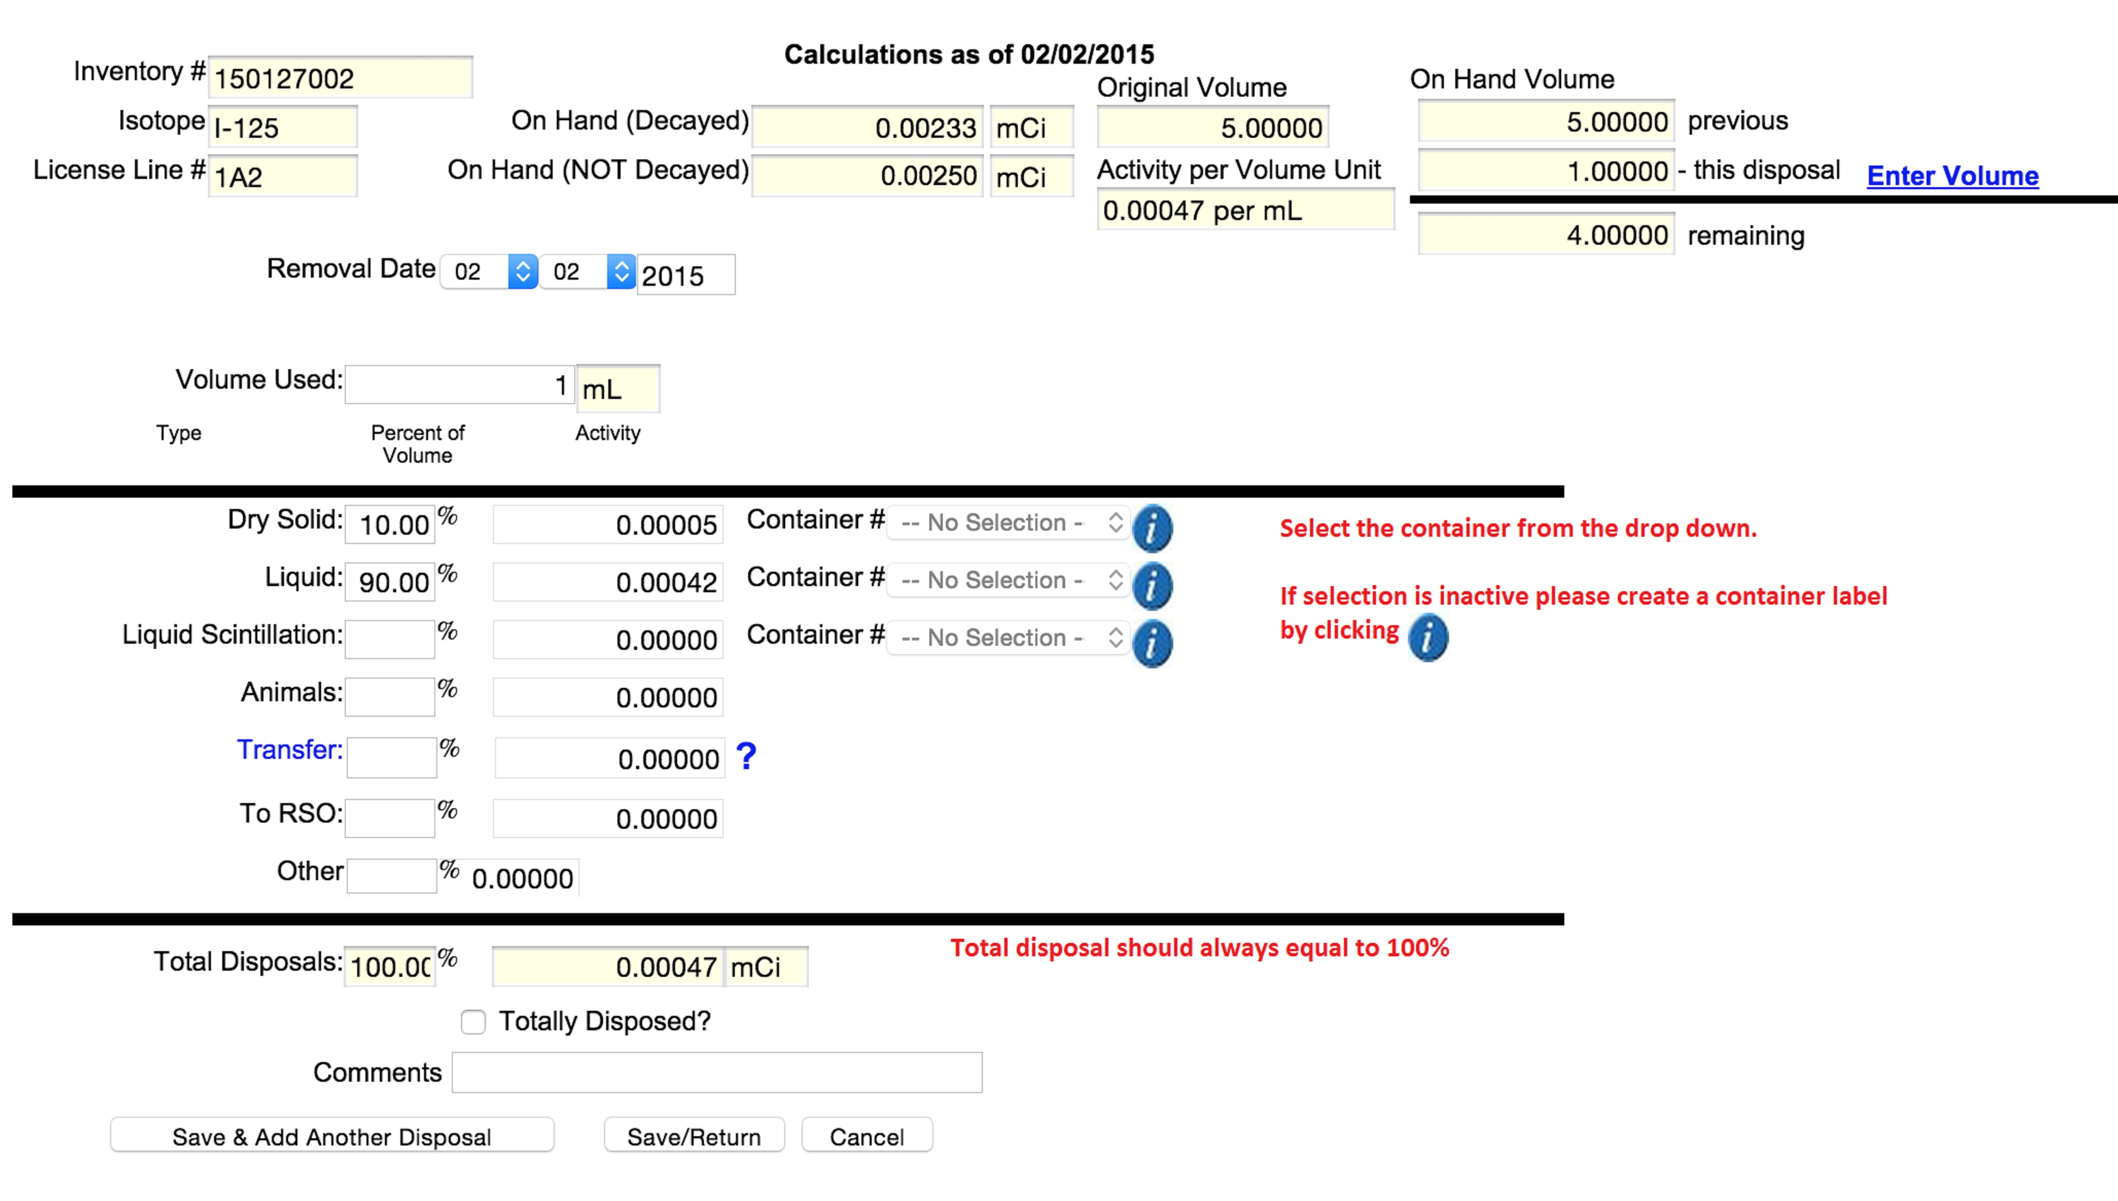
Waste Container selection

Slide 8
Adding waste container

Slide 9
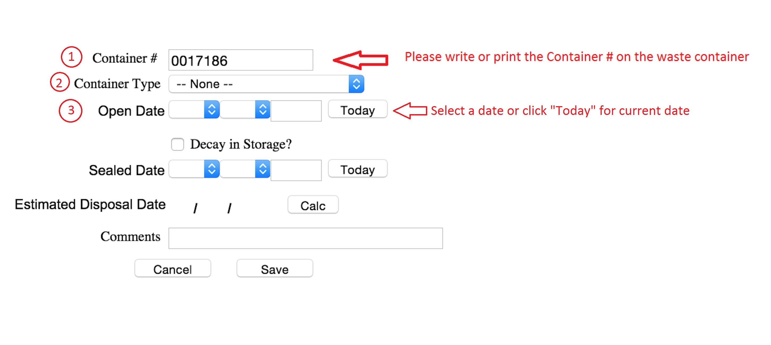
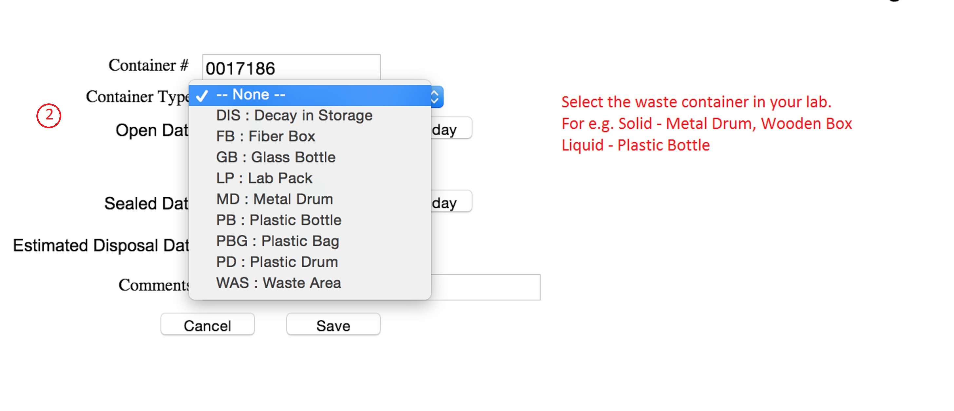
Waste Container

Slide 10
Waste Container Selection

Slide 11
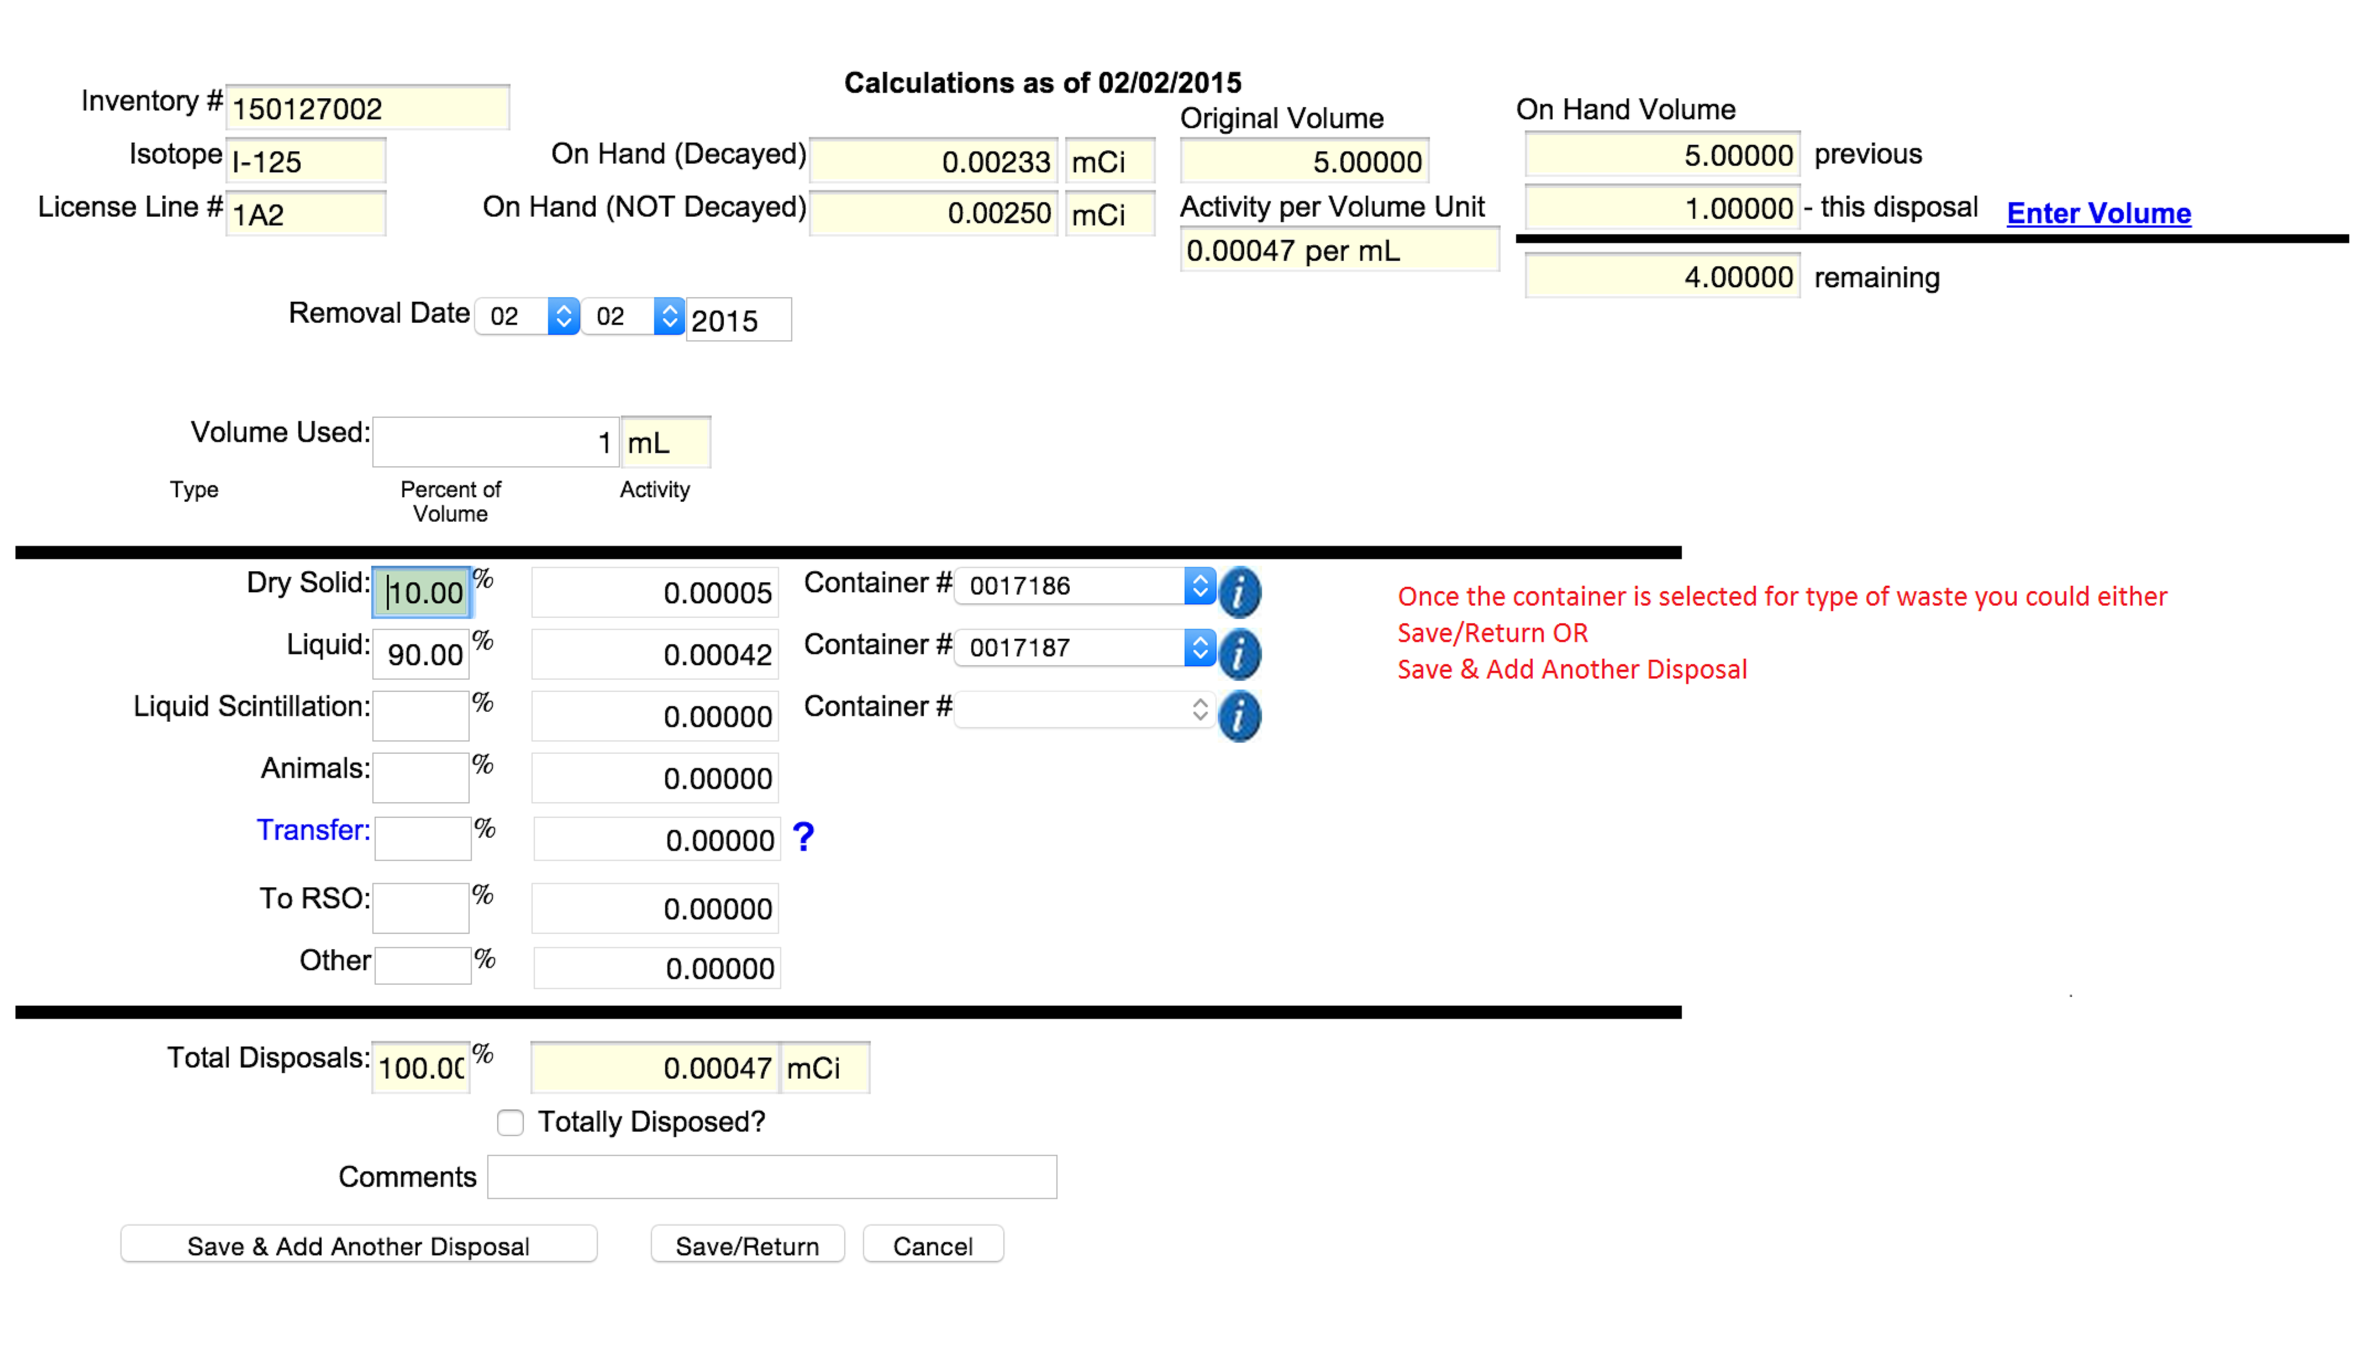
Usage and Disposal Log Complete

Slide 12
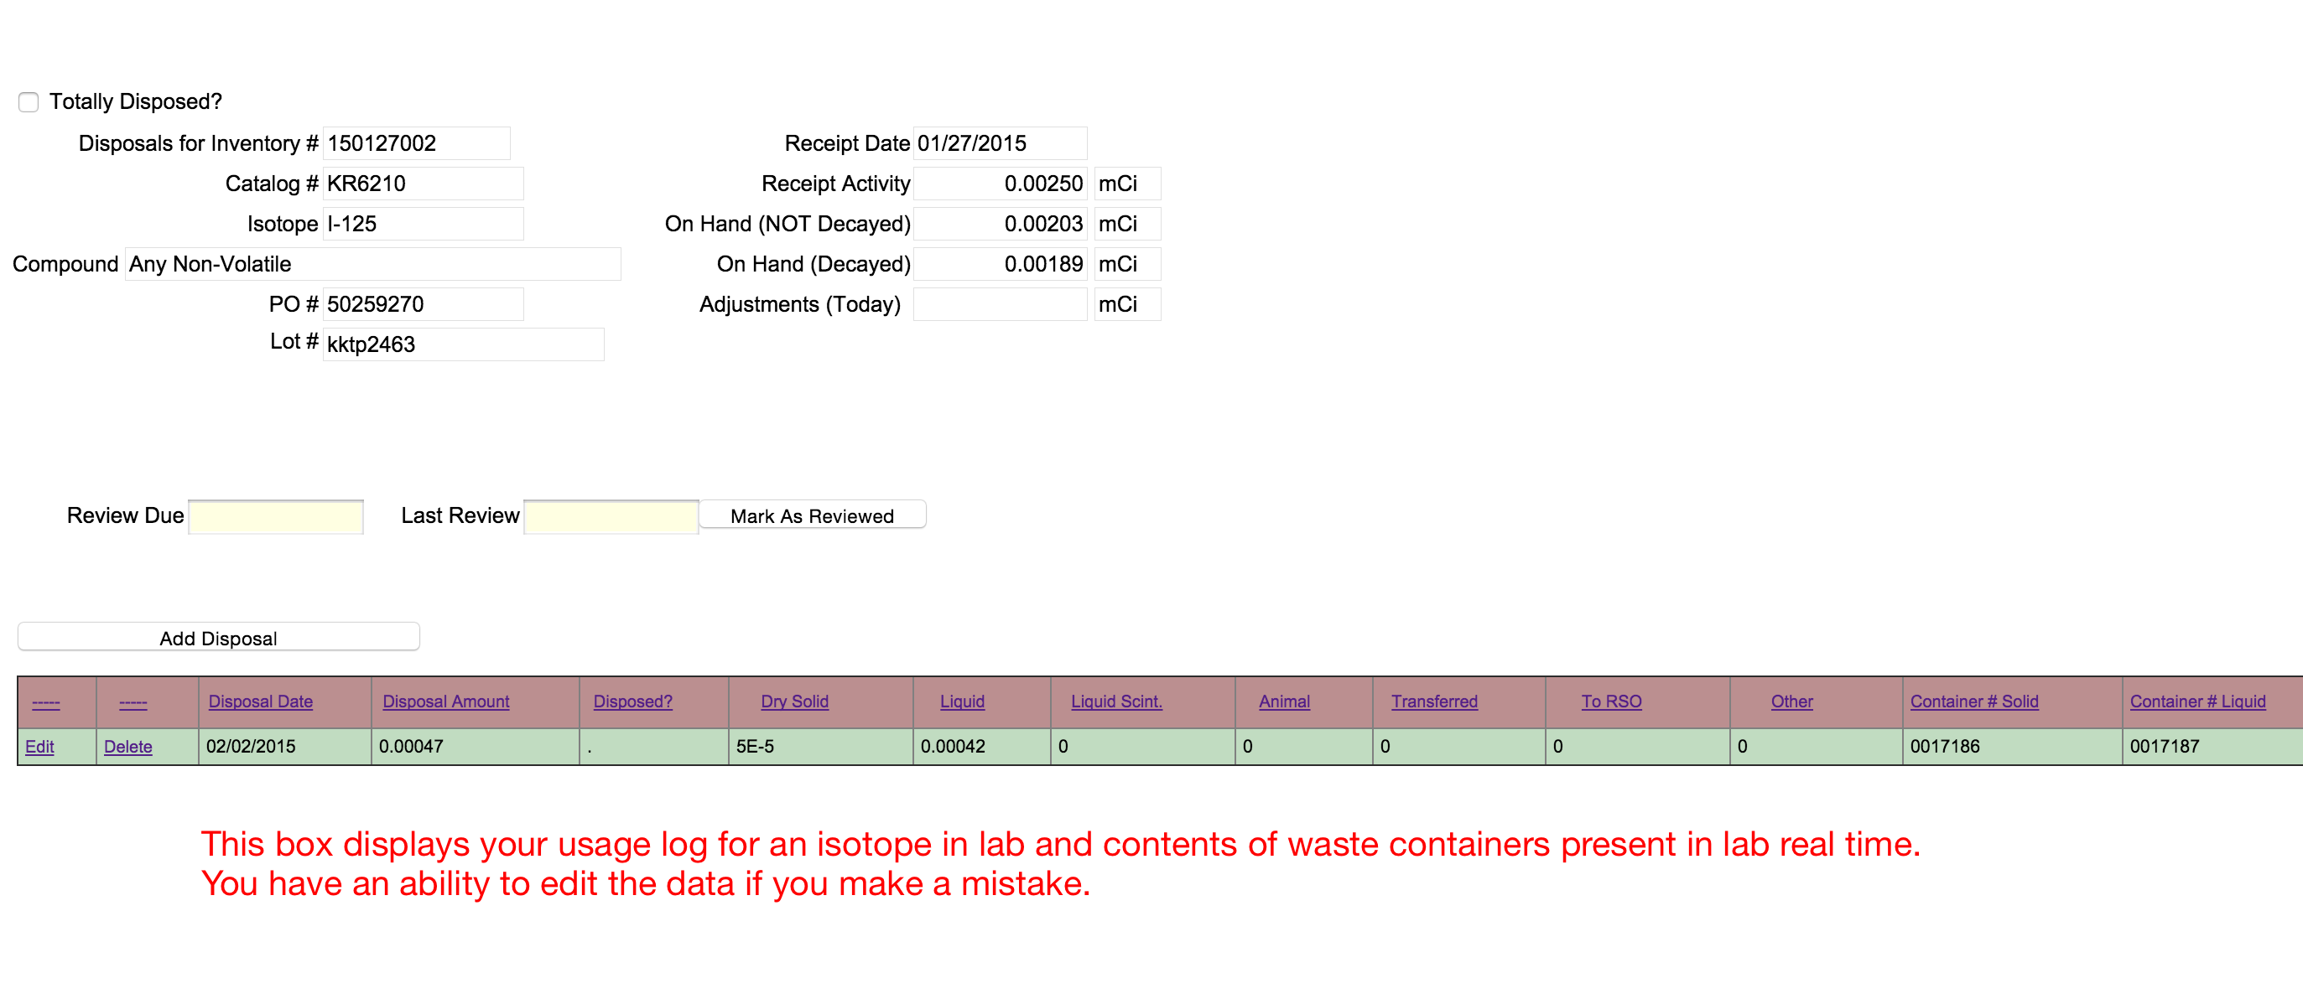
Usage and Waste log

